Slide 1

Bus Schedule Management System & Route Wise Load Tracking System
Submitted by:
1.KOLLAPANENI BHAVYA CHOWDARY-20BCS116
2.GURRAM SAIEESHA-20BEC042
3.GODAVARTHI HEMANVITHA-20BCS089
CSE, 2024
Submitted to:
Prof.Pritee Khanna
PDPM INDIAN INSTITUTE OF INFORMATION TECHNOLOGY DESIGN AND MANUFACTURING JABALPUR,INDIA.
NOVEMBER 16, 2021.

Slide 2
CONTENTS:
1. Introduction
2. Purpose & Scope
3. Users
4. Overall Description
a. System Features and Requirements
b. Functional Requirements
c. External Interface Requirements
d. Non-functional Requirements
5. Technology Used
6. Database Designing
a. Entity Relationship Diagram(ERD)
7. Project Screenshots

Slide 3
1.INTRODUCTION The name of our project is Bus schedule management system and Route wise load tracking system in IIITDMJ. Buses are the most frequently available and most used vehicle for going from small distance trips to very long trips. This project is to implement the bus schedule management and route wise load tracking system in IIITDMJ.
2.PURPOSE & SCOPE
The Bus Management System is being developed to provide a tool for our college to easily maintain the college bus information. At the start of the project setup, it provides an interactive part to store information about buses; different routes of buses, Schedule information, and seats available etc.
During the period of finalizing the idea of the system , the primary goal was to design the system that will be easy to use for those who don’t know how to handle the software. As designing work began and things started taking shape, the system got developed to a stage where it would be used by entry level.

Slide 4
Bus Management System will include the buses information, driver's information. Search function are also added so that user can search for bus information that has been stored in the databases. Any colleges/ schools/travelling agencies can make use of this application providing information about the location of the vehicles. This system would provide basic set of features such as adding or updating routes and locations in the database.
3.USERS
Admin
Student
4. OVERALL DESCRIPTION
System Features and Requirements :
The system wants a minimum of two GB of ram to run all the options sleek and unforeseen.
It wants a minimum 1.3 gigahertz processor to run smoothly as else which will produce issues.
The system must be operated by some approved person as wrong hands will build it happy-go-lucky.

Slide 5
Rest is all up to the user’s usage can take care of the hardware.
For security opposing anti-virus is suggested.
b. FUNCTIONAL REQUIREMENTS
The functional requirements of the bus management system are those requirements that are necessary to the eye of the user and the client.
Registering User
Updating User
Login
Functionality and modules of the project:
Admin – This module is used for admin login
Logout functionality
Change Password Functionality

Slide 6
Features of Bus Module:
Admin can add new Bus records
Admin can see the list of Bus details
Only admin can edit and update the record of the bus
Admin will be able to delete the records of the Bus
Features of Admin Module:
Admin can add new login records
Admin can see the login details
Only admin can edit and update the record of the Login
Admin can change the password
Bus Management Module:
Adding New bus details
Edit the Existing bus details
View all the details of the Buses
Listing of all buses

Slide 7
c. External Interface Requirements
Software Requirements:
Visual Studio
XAMP SQL Server
Operating System
Windows 10
Hardware Requirements:
PC with dual core or more processor
1 GB RAM or Above
180GB Hard Disk or Above

Slide 8
d. Non - functional Requirements
Reliability: The application should be reliable and it should generate all updated information in correct order.
Availability: Application will be available and working properly for all the time.
Security
5. TECHNOLOGY USED:
HTML: Page layout has been designed in HTML​
CSS: CSS has been used for all the designing part ​
JavaScript: All the validation task and animations has been done using javascript
PHP: All the business and frontend logic has been implemented ​
MYSQL : MySQL database has been used as database for the project​
Apache2: Project will be run over the Apache2 server​
You can run this project on XAMP, LAMP, WAMP or MAMP​

Slide 9
6.DATABASE DESIGN
a. ER DIAGRAM
Employ _ date
Finish point
Route_id
D name
Start point
Route_id
Driver _
id
Location_id
ROUTE
DRIVER
Stops in
STOP
travels
Location_name
Drives
Day
Out_
time
ID
Bus_id
status
BUS
schedule
ADMIN
Bus
Name
fname
Bus_id
start
Driver _ id
end
Pass
word
lname

Slide 10
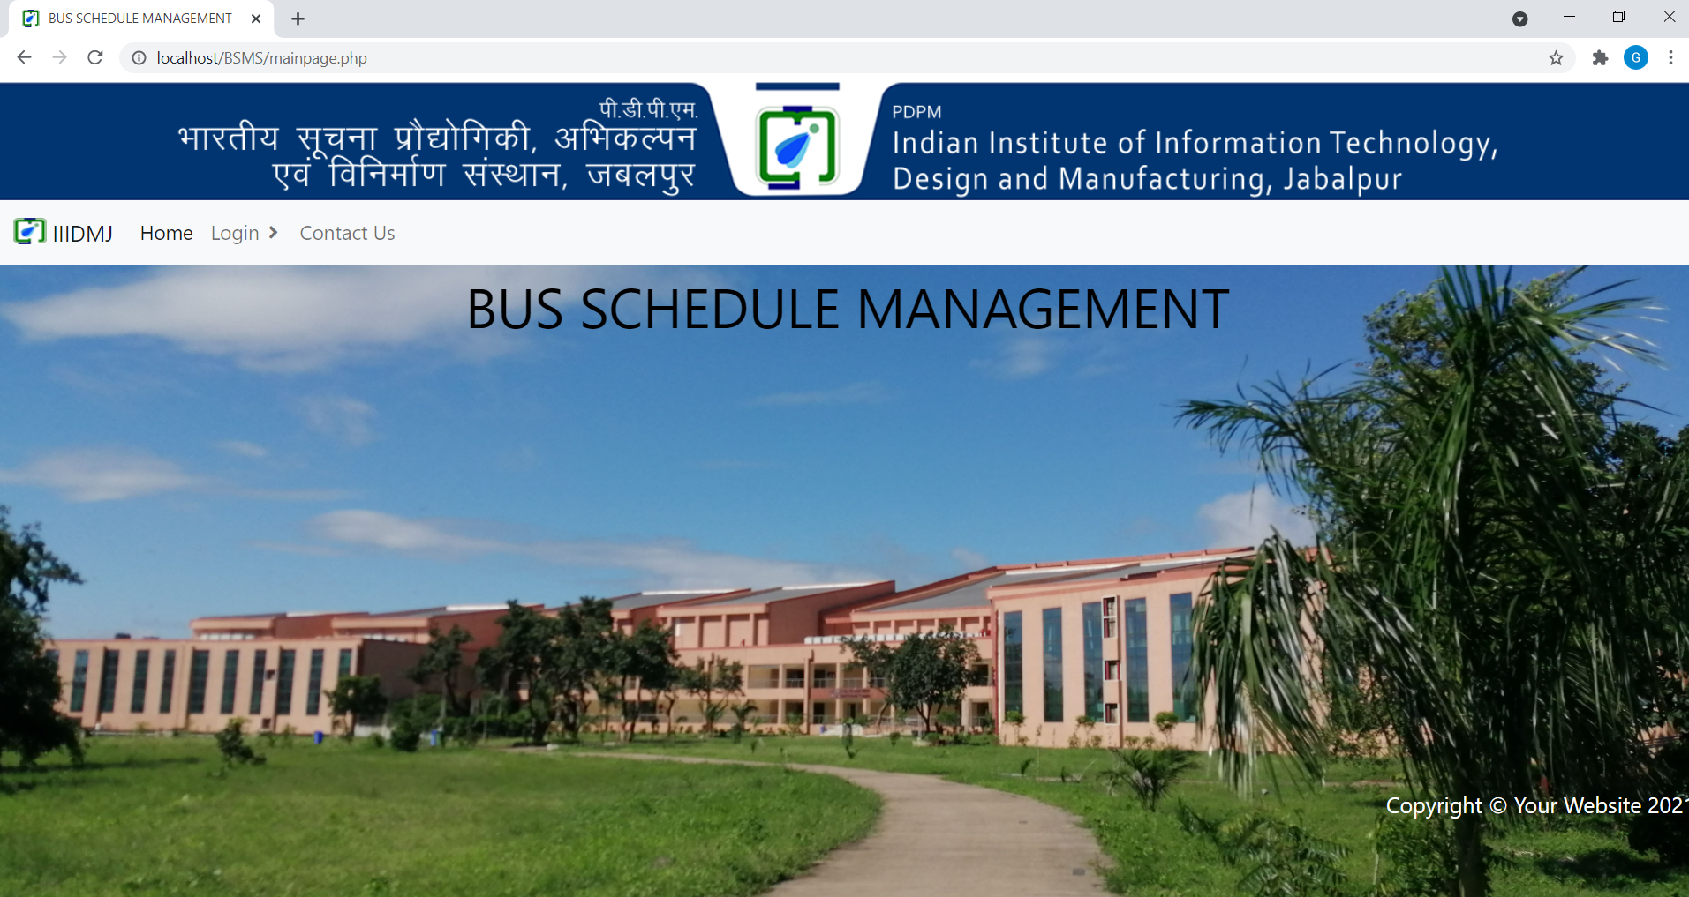
7.PROJECT SCREENSHOTS
Main page:

Slide 11
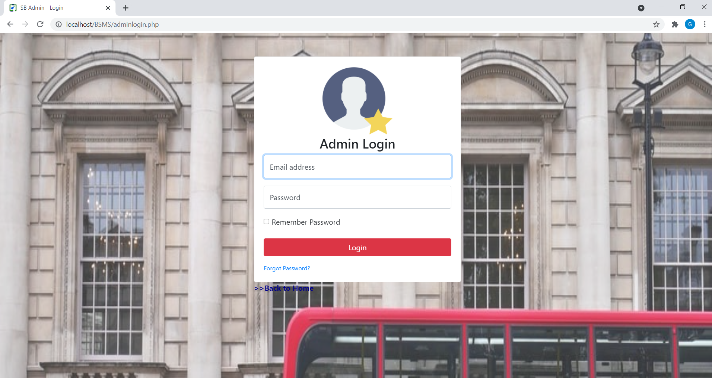
Admin login:

Slide 12
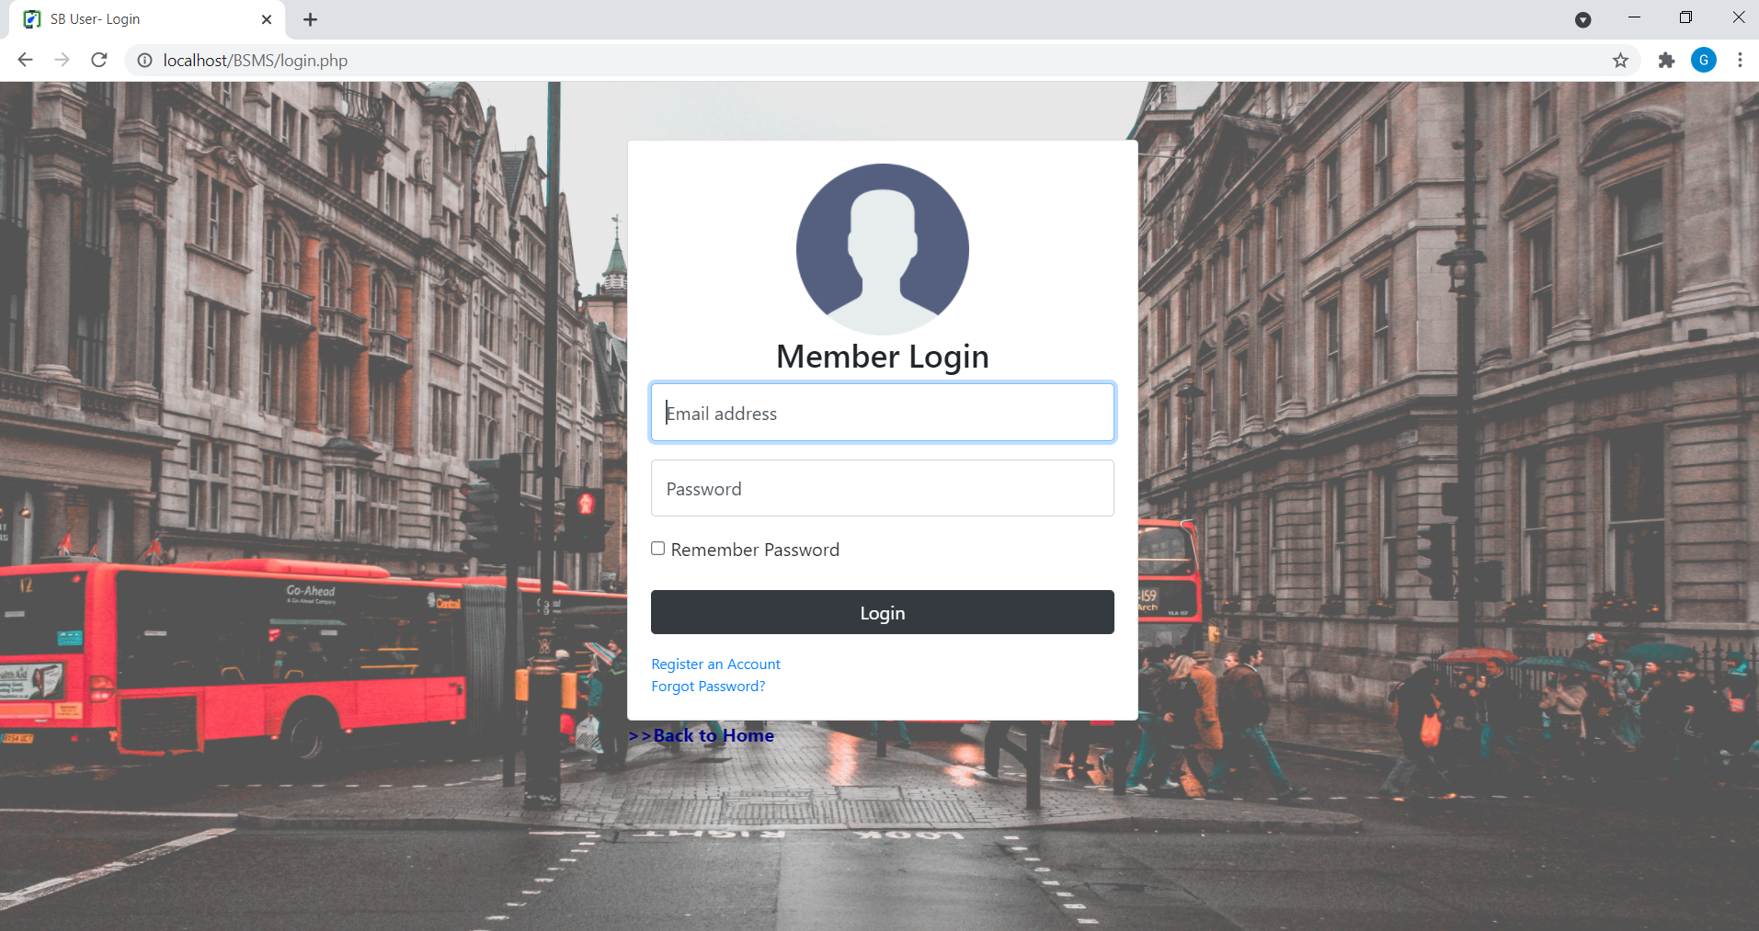
Member login:

Slide 13
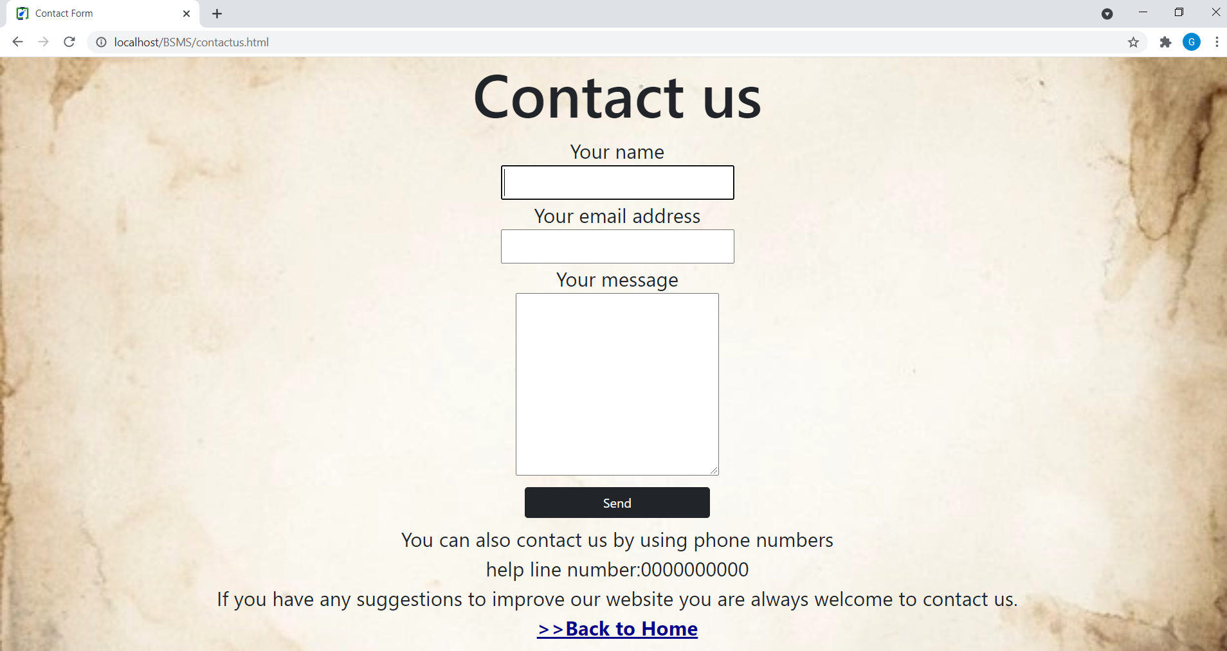
Contact us:

Slide 14
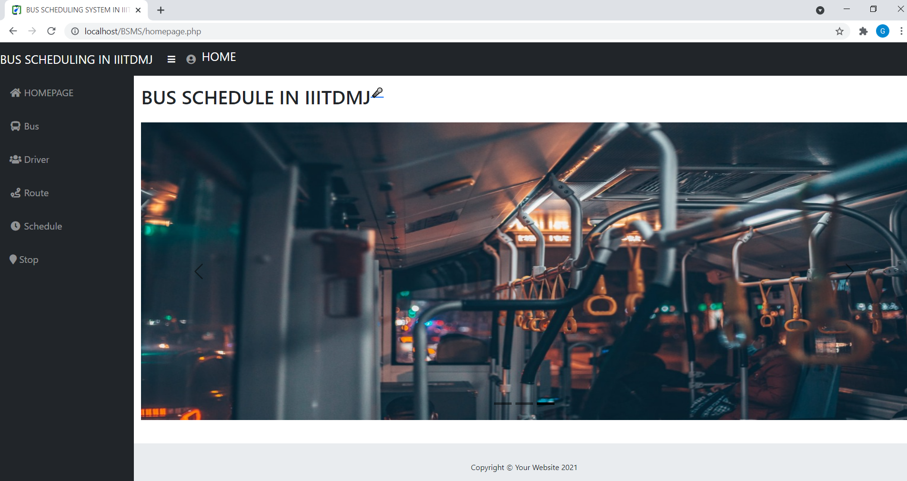
Homepage:

Slide 15
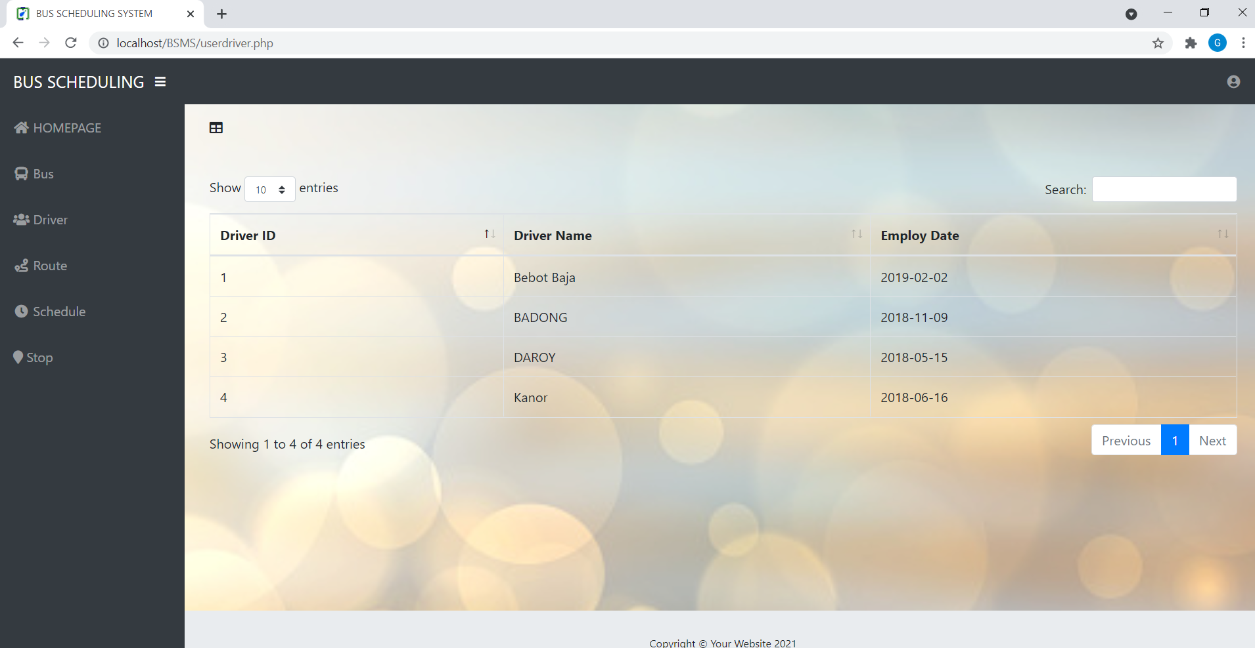

Slide 16
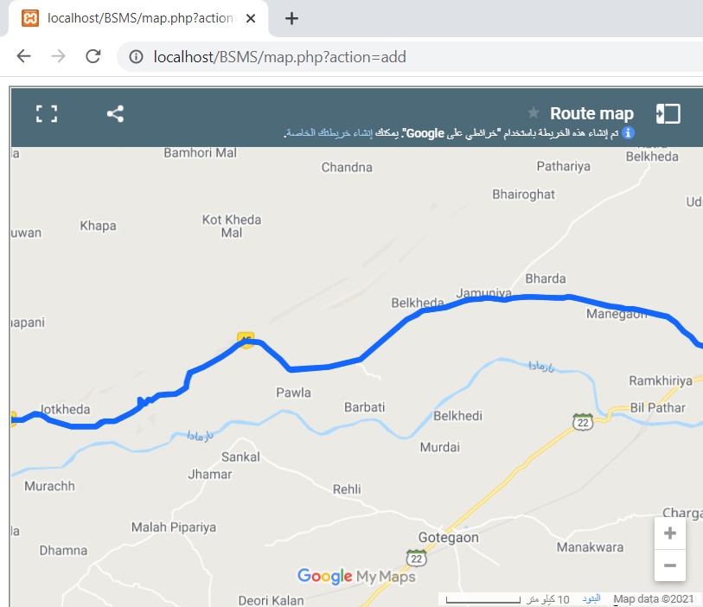

Slide 17
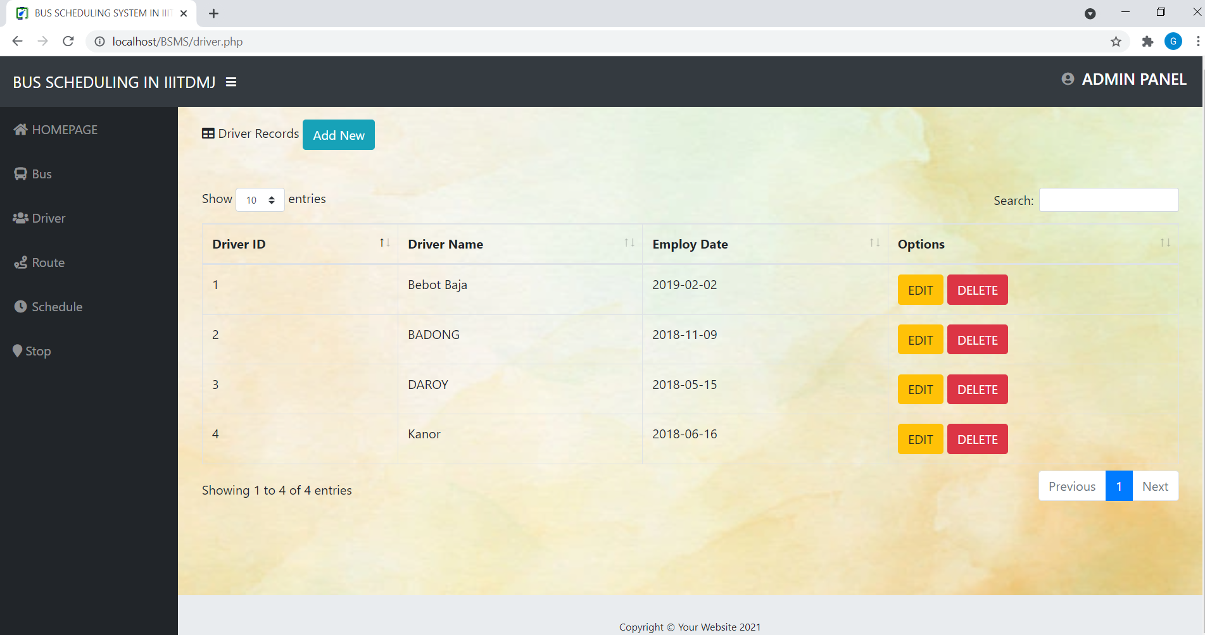

Slide 18
ThankYou

